Slide 1

Powered by Amazon Web Services (AWS)

Slide 2
Who gets access?
For the purpose of this data plan, the following individuals and/or departments will have access to the data stored in Amazon S3.
IT management
Health Information Management (HIM) Department, this includes but is not limited to:
HIM Manager/supervisor
Revenue Cycle Manager
Medical Auditor
Privacy Officer/Data Governor
Health Information Analyst
CEO and the entire Board of Directors
Records Processor

Slide 3
Gather around, I got a story to tell
This step of the proposed data plan includes a storyboard, which is essentially a visual representation of a sequence of events (actions) depicted of a particular person or group of people. This is typically done for movies, plays or commercials, but for the purpose of this plan, it’s important that Hardrock Health is fully informed of 2 main positions, what actions/purpose they serve, and why user access is necessary.

Slide 4
User scenario 1
Records processor – Diane
Gets file from Health Information Management department records
Records come from patients
Reports to HIM manager
Records processor – Diane
Uploads data into Amazon S3 using Direct Connect
Has firsthand access to sensitive information
Records processor – Diane
Gets file from Health Information Management department records
Records come from patients
Reports HIM Manager
HIM Manager – Aiyokee
Reports to HIM Department Head and Analyst
Runs and submit reports regarding file processor/s KPI and statistics
HIM Manager – Aiyokee
Needs constant access to HIM department data
Must run, summarize and submit daily, weekly, monthly, quarterly, annual processor FPH, error out and compliance reports
Must submit info to HIM Department Head and Analyst

Slide 5
User scenario 2
Data Scientist – Ach’Mood
Gets access to all data being uploaded into Amazon S3
Reports to Senior Data Scientist, Data Engineer and HIM Department Head
Data Scientist – Ach’Mood
Must maintain visual of department security, compliance and overall productivity.
Must provide monthly, quarterly and annual report and summary
May also recommend changes and/or other implementations to promote productivity and constant growth
Data Scientist – Ach’Mood
Reports to a lot of people
Must have access to Amazon Glacier and Document DB as well to compare data
Tries to make sure there is some level of Data Governance
Also enforces data governance
Must work with superiors to constantly update and maintain compliance guidelines
Data Scientist – Ach’Mood
Must work with superiors to constantly update and maintain compliance guidelines
May work closely with processors

Slide 6
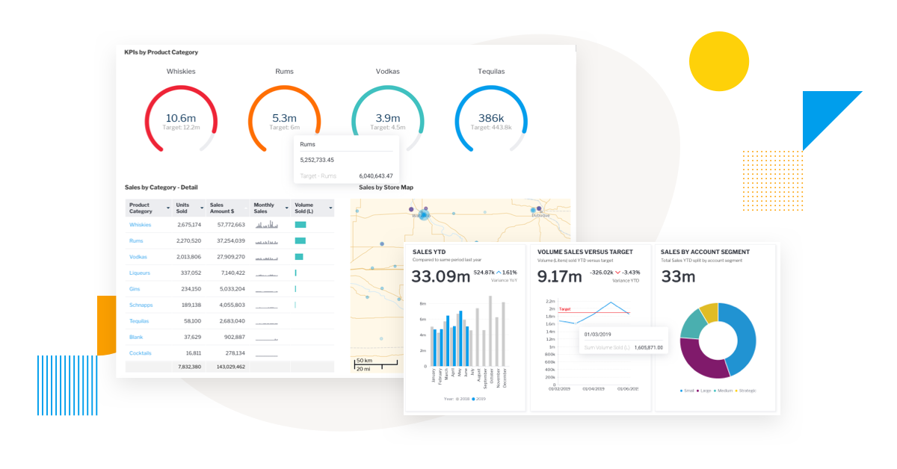
Let’s get a visual
What better way to represent hundreds or thousands of data sets than some sort of visual? While rows upon rows of data may be hard to understand or see any type of trend, some visual representation will allow the data to “tell its own story” via trends or lack thereof.
For Hardrock Health, it has been determined that the best visuals for data are:
Key Performance Indicators (KPI) – This would be represented with data from file processors and mainly be represented via dashboards complied with 3 or more pie charts. This will allow the user to see trends over time to indicate how they are performing regarding their job duties, such as accuracy, compliance and processing speed.
Bar and/or Line charts – This would mainly represent each processors Files Per Hour (FPH), which also contributes to the overall KPI percentage. It allows its user real time and past statistics of their productivity and potentially how they will perform in the future by allowing a side-by-side comparison of how many or little files are being processed and how many hours of their shift is used to be “productive” by processing said files.

Slide 7
Business Intelligence (BI)
BI is usually described as an accumulation of technology, methods, architecture and best practices that are used to transform data into information that is beneficial to a business. It’s usually implemented and enforced by software and/or services from a 3rd party source. Hardrock Health will use the following software:
Software | Perks and uses
Amazon QuickSight | 2 of the best things about QuickSight are: It is supported/compatible with Amazon S3 data sources User access is included in Amazon S3 and is free up to 1GB of SPICE capacity It is also cost effective and maintains scalability depending on the size of the applicable data set. QuickSight allows users to view existing data, set user permissions and create analysis on a data set, as well as using analytical queries.
Amazon SageMaker | Compliments QuickSight by foreseeing or making predictions based on past data trends. Being able to utilize this side by side data comparison allows business to make decisions that ensure constant improvement and maintains current practices that provide a positive influence.

Slide 8
References
uCertify. (2022).Data science capstone.uCertify
Healthcare Management: Job Description And Requirements. Ultimate Medical Academy. (n.d.). https://www.ultimatemedical.edu/blog/healthcare-management-job-description-and-requirements/

